Slide 1
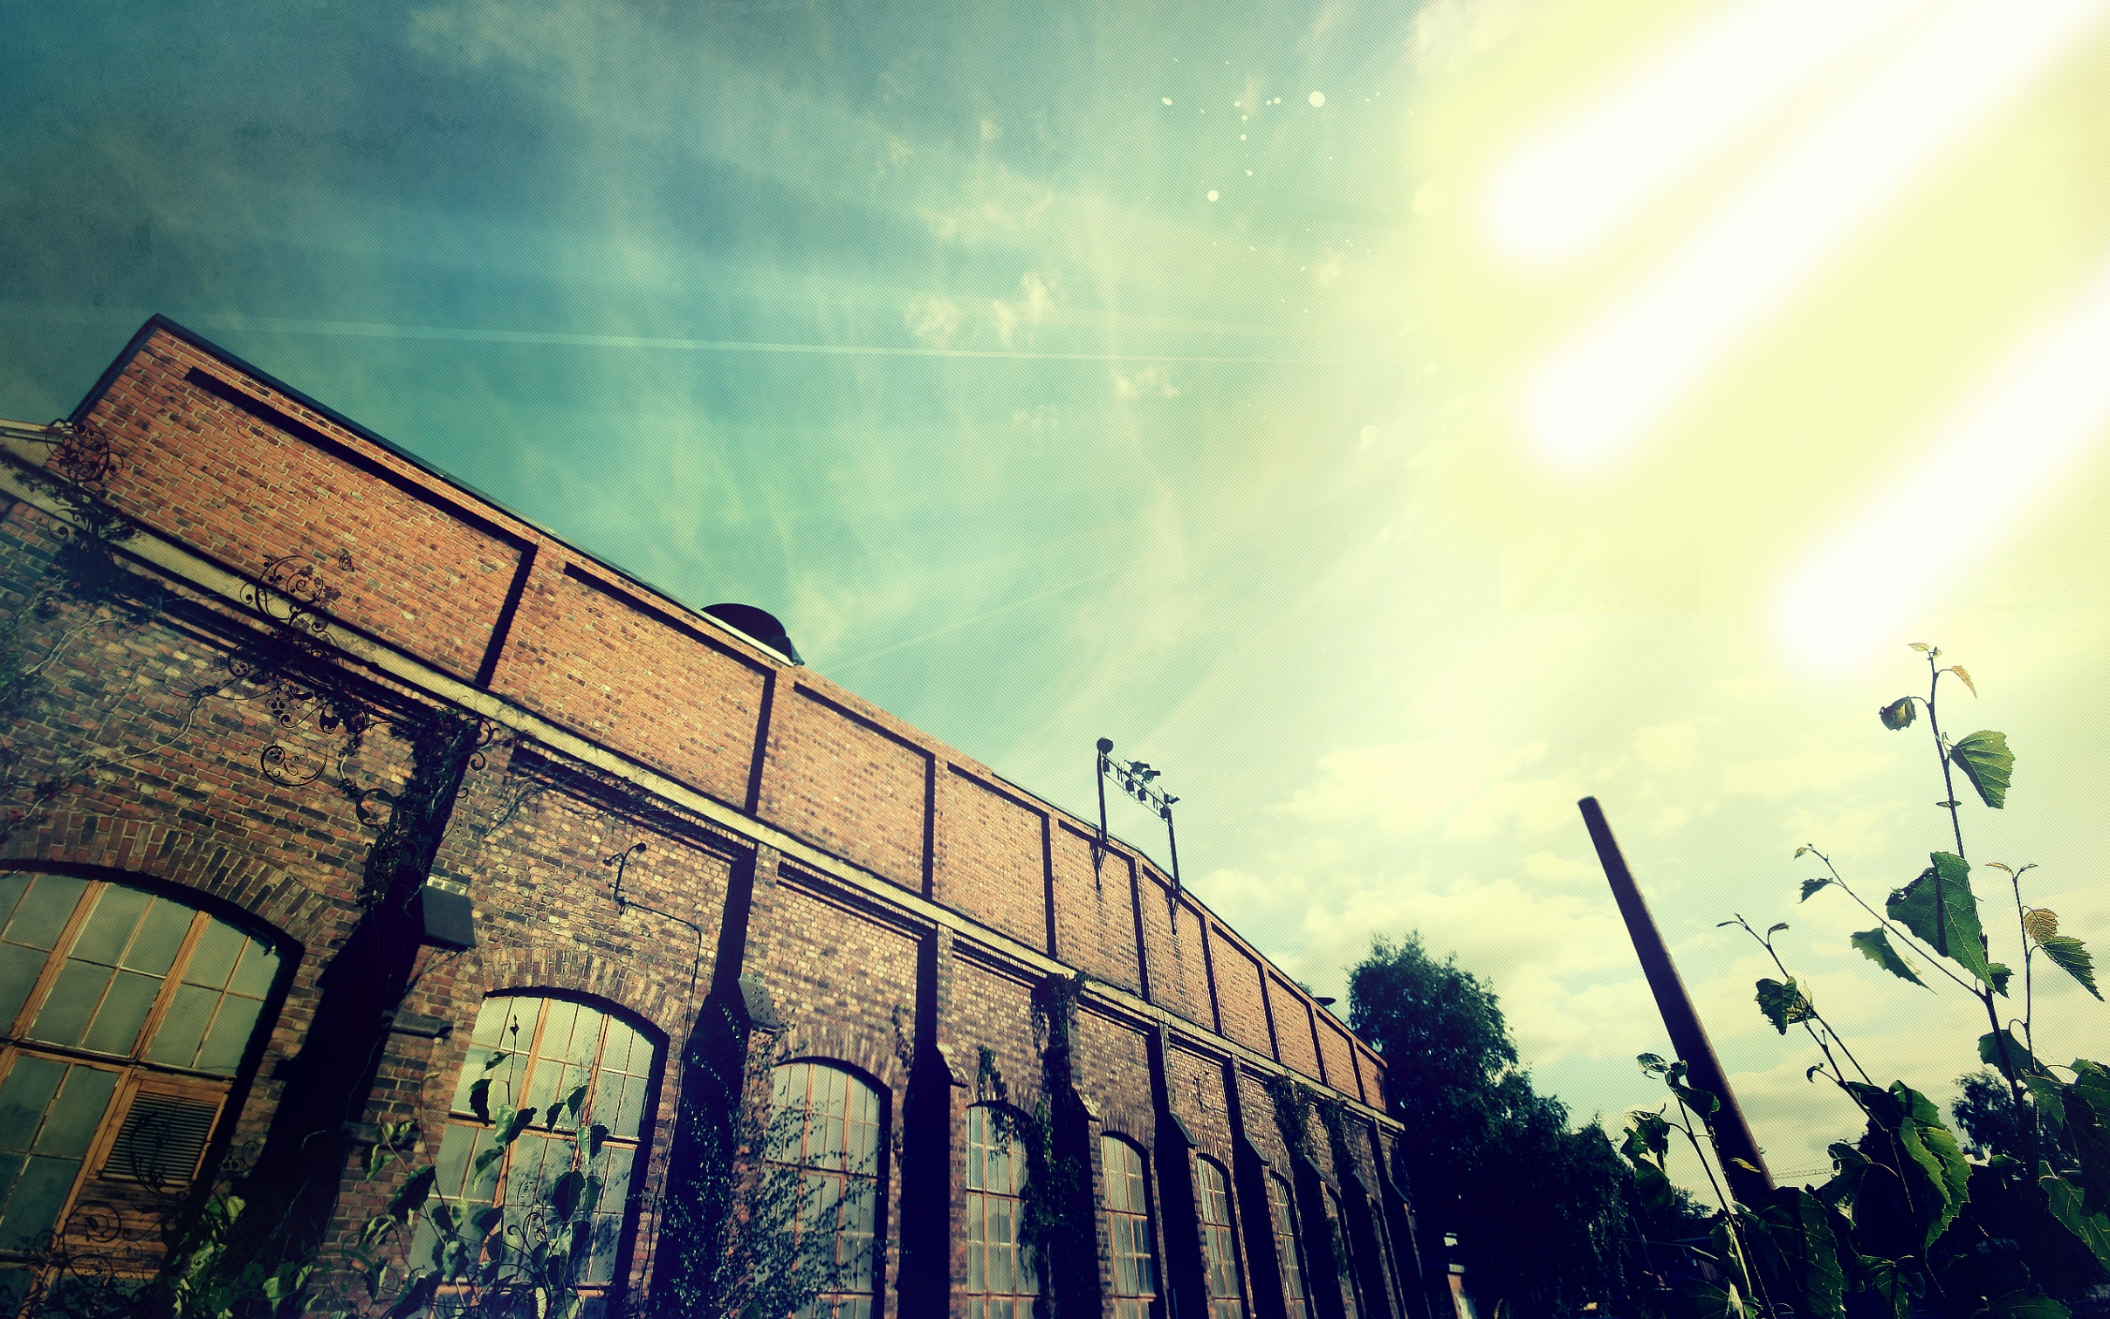
>>Summer
MISSIONS<<
>>Portland2019<<

